Slide 1
Image Thresholding
Changing value of element in to 255 (white) to it’s value crosses 150 and if not it will be changed to 0 (black)
img[img > 150] = 255
img[img <= 150] = 0
Predefined function is there for thresholding
cv2.threshold(<grayscaleimage>, threshold value, max value, threshold style)
Ex: cv2.threshold(gray, 128, 255, cv2.THRESH_BINARY)

Slide 2
Adaptive thresholding
A global value as threshold value may not be good in all the conditions where image has different lighting conditions in different areas. In that case, we go for adaptive thresholding.
Adaptive Method - It decides how thresholding value is calculated.
# cv2.ADAPTIVE_THRESH_MEAN_C : threshold value is the mean of neighborhood area
th = cv2.adaptiveThreshold(img, 255, cv2.ADAPTIVE_THRESH_MEAN_C,\ cv2.THRESH_BINARY, 11, 2)

Slide 3
Bitwise operations on images
# Inverse of the image
Inv_img = cv2.bitwise_not(img)
# Bitwise And operation
bit_and = cv2.bitwise_and(img, img, mask)
# Bitwise Or between 2 images
bit_or = cv2.bitwise_or(img1, img2)

Slide 4
Image smoothing
Image blurring is achieved by convolving the image with a low-pass filter kernel. It is useful for removing noise. It actually removes high frequency content (e.g: noise, edges) from the image resulting in edges being blurred when this filter is applied. (Well, there are blurring techniques which do not blur edges). OpenCV provides mainly four types of blurring techniques.
Example : Average Blur

Slide 5
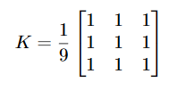
Average blur
This is done by convolving the image with a normalized box filter. It simply takes the average of all the pixels under kernel area and replaces the central element with this average
cv2.blur() or cv2.boxFilter() are used.
b = cv2.blur(img, (5, 5))

Slide 6
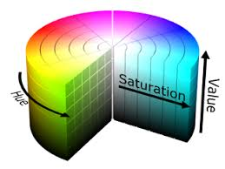
HSV
HSV is Hue Saturation Value.
Hue means the colour content. It is measured in degrees.
Saturation is the colour concentration of the specific colour.
Value means the Brightness concentration of the colour specified.

Slide 7
Range in hsv colour space
For object Tracking, setting range of colors in image is useful.
cv2.inRange() function is used for setting range.
lower_r = np.array([170, 70, 50]) //Lower limit for the red color in hsv image
upper_r = np.array([180, 255, 255]) //Upper limit for the red color in hsv image
lower_g = np.array([50, 120, 120])
upper_g = np.array([80, 255, 255])
lower_b = np.array([83, 120, 120])
upper_b = np.array([170, 255, 255])
mask = cv2.inRange(hsvimg, lower_r, upper_r) //Outputs mask of red color in hsv image

Slide 8
Contours in opencv
Contours is a curve joining all the continuous points (along the boundary), having same color or intensity.
cv2.findContours() is used to get contours of an image
im2, contours, hierarchy = cv2.findContours(thresh, cv2.RETR_TREE, cv2.CHAIN_APPROX_SIMPLE)
thresh is grayscale image with threshold applied
contours is the list of all contours present in the given image

Slide 9
Drawing Contours
Contours extracted by the cv2.findContours() function can be drawn on an image by using cv2.drawContours() function.
cv2.drawContours(img, contours, idx, color, thickness)
# To draw all the contours at once:
cv2.drawContours(img, contours, -1, (0,255,0), 3)
# To draw 4th(say) contour:
cv2.drawContours(img, contours, 3, (0,255,0), 3)

Slide 10
Contours Properties
Contour Area:
-Contour area is given by the function cv2.contourArea()
area = cv2.contourArea(cnt)
Contour Perimeter:
-It is also called arc length.
-It can be found out usingcv2.arcLength()function.
perimeter = cv2.arcLength(cnt, True)

Slide 11
Contours Properties
Moments:
- help you to calculate some features like center of mass of the object, area of the object etc.
From this moments, you can extract useful data like area, centroid etc. Centroid is given by the relations.
. This can be done as follows:
M = cv2.moments(cnt)
cx = int(M['m10']/M['m00'])
cy = int(M['m01']/M['m00'])

Slide 12
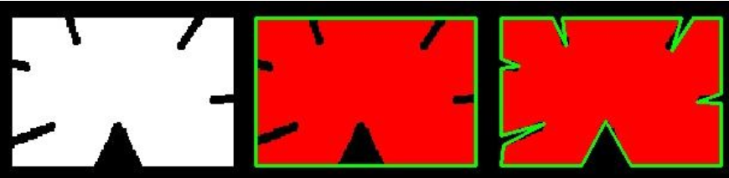
Contour properties
Contour Approximation:
- It approximates a contour shape to another shape with less number of vertices depending upon the precision we scontourpecify.
“epsilon” is maximum distance from to approximated contour.
epsilon = 0.1*cv2.arcLength(cnt,True)
approx = cv2.approxPolyDP(cnt,epsilon,True)

